Slide 1
Serial communication

Slide 2
Overview
Types of data transmission
Types of serial data communication
Asynchronous data transmission
Examples of data transmission
Data transmission rate

Slide 3
Types of data transmission
Serial
Parallel
Receiver
Receiver
1 bit
1 word
Transmitter
Transmitter

Slide 4
Types of data transmission

Slide 5
Comparison
Serial
Parallel
Cost
Speed
Transmission Amount
Transmission Lines
Transmission Distance
Example
Cheap
Slow
Single bit
One line to transmit one to receive
Long distance
Modem
Expensive
Fast
8 bits (8 data lines) Transmitter & Receiver
8 lines for simultaneous transmission
Short distance (synchronization)
Printer Connection

Slide 6
Synchronous - SPI
Constant transmission of data
Clocks of Transmitter and Receiver must be synchronized
No safeguard against error or noise
Data rates depend on clock rates
Flexible to communication with peripheral devices
LCD drivers, A/D converter, other microprocessors
Simultaneously transmits and receives data
Transmission line, Receiving line, and Ground

Slide 7
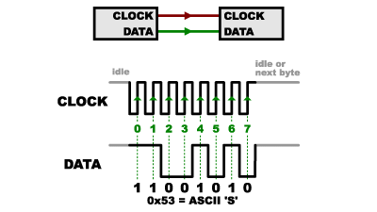
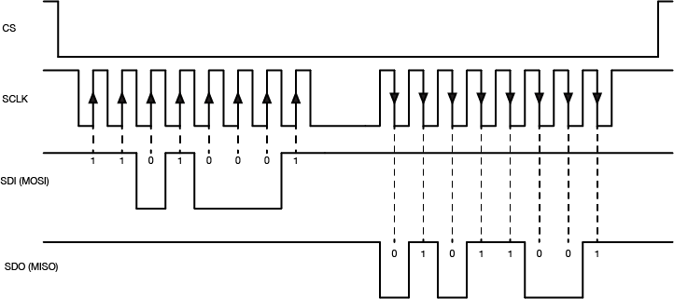

Slide 8
Asynchronous - SCI
Transmission of data through “words”
Continuous transmission unnecessary
Built-in safeguards against noise and error
Transmitter and Receiver operate independently
Requires start and stop bit for each byte of data
Sends constant ‘1’ for idle
Sends a ‘0’ for start and “1” for stop bits
Very reliable data reception

Slide 9
Settings
Set the Baud Rate of the Transmitter and Receiver (same value)
Set the number of data bits (8 or 9) for Transmitter/Receiver
Set the parity bit

Slide 10
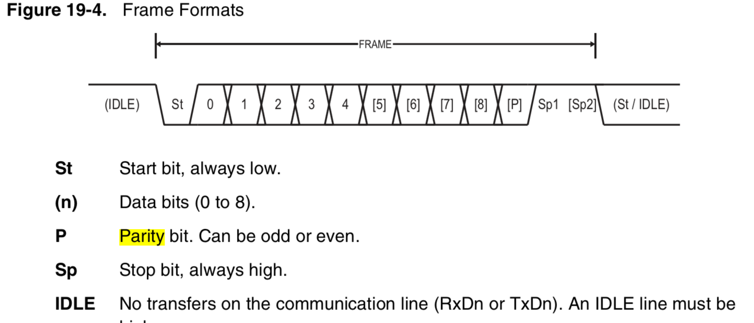
Bit types
Start Bit
Data Bit
Parity Bit
Stop Bit

Slide 11
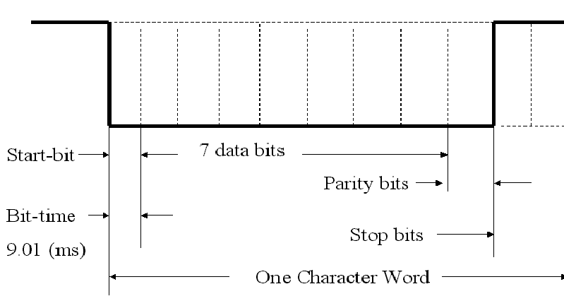
Bit types
Start Bit –
Signals the transmission of a word.
Transition from “1” to “0”. (“Mark-to-space”)
First bit to be transmitted.

Slide 12
Bit types
Stop Bits –
Bit at the end of a data word.
Bit set to high “1”.
Indicates the end of a word.
Data bits –
Data bits to be transmitted.
Sender and receiver have to agree in the number of data bits. (Usually 8 or 9)
Least significant bit is sent first.
Can be low or high.

Slide 13
Bit types
Parity bit –
Works as an error check.
There are two types: odd and even
Even: if number of 1’s in the data word is even.
Odd: if number of 1’s in the data word is odd.
Bit after the data bits and before the stop bit.
Can prevent single noise signal but does not recognize when two bits are altered by noise.
Used to prevent noise.

Slide 14
Asynchronous transmission
Example 1:
Send 8B₁₆ with one start bit, 8 data bits, even parity, and two stop bits.
8B₁₆=10001011₂
Start Bit
Data Bit 0
Data Bit 1
Data Bit 2
Data Bit 3
Data Bit 4
Data Bit 5
Data Bit 6
Data Bit 7
Parity Bit
Stop Bit
Stop Bit
0
1
1
0
1
0
0
0
1
0
1
1
First bit sent

Slide 15
Asynchronous transmission
Example 2:
Send 8C₁₆ with one start bit, 8 data bits, even parity, and two stop bits.
8C₁₆=10001100₂
Start Bit
Data Bit 0
Data Bit 1
Data Bit 2
Data Bit 3
Data Bit 4
Data Bit 5
Data Bit 6
Data Bit 7
Parity Bit
Stop Bit
Stop Bit
0
0
0
1
1
0
0
0
1
1
1
1
First bit sent

Slide 16
Asynchronous transmission
Example 3:
Send 8C₁₆ with one start bit, 8 data bits, odd parity, and two stop bits.
8C₁₆=10001100₂
Start Bit
Data Bit 0
Data Bit 1
Data Bit 2
Data Bit 3
Data Bit 4
Data Bit 5
Data Bit 6
Data Bit 7
Parity Bit
Stop Bit
Stop Bit
0
0
0
1
1
0
0
0
1
0
1
1
First bit sent

Slide 17
Baud Rate vs Bit Rate
Baud rate: number of total information bits transmitted per second (includes start, data, parity and stop bits)
Bit rate: number of data bits only transmitted per second
So for us, Baud rate > Bit rate

